Slide 1
Prolonged Exposure for PTSD and Moral Injury: Active Duty Case Example
Wyatt R. Evans, PhD
UT Health San Antonio
STRONG STAR & Consortium to Alleviate PTSD

Slide 2
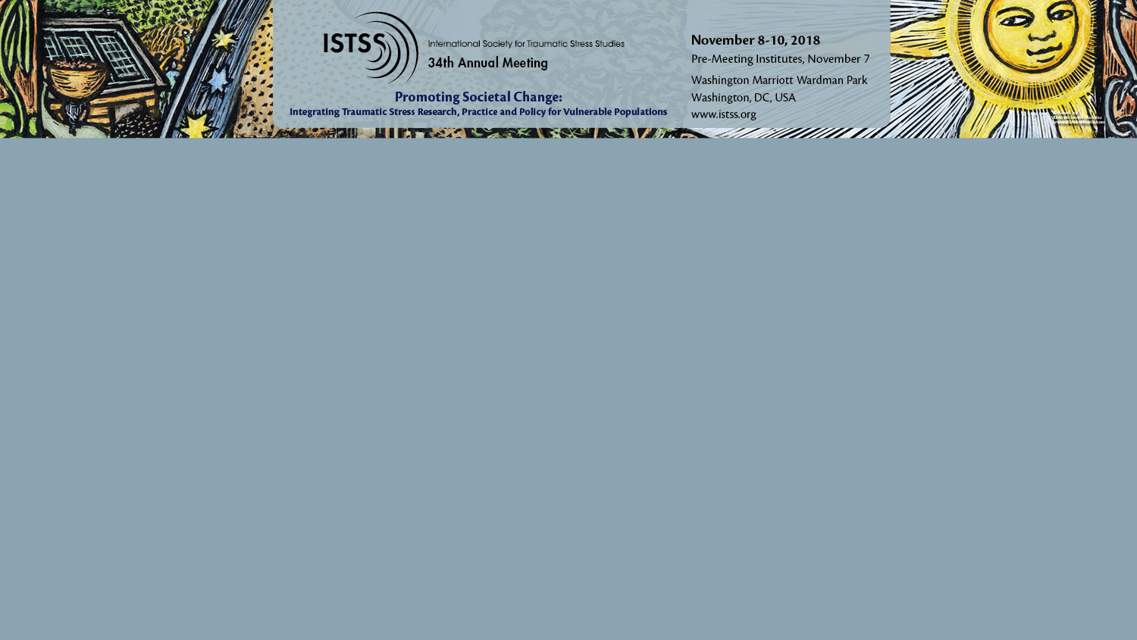
Continuing Medical Education Commercial Disclosure I, Wyatt Evans, have no commercial relationships to disclose.

Slide 3
SPC Jacobs*
27-year-old White male
Soldier in the U.S. Army
Served 2.5 years with 1, nine-month deployment
Medevac from Iraq in 2016
Married 6 years
2 children under age 6
Christian; regular church involvement since childhood
(Evans et al., under review)
*Some personal & military demographic details changed to protect the soldier’s confidentiality

Slide 4
Treatment
Prolonged Exposure Intensive Outpatient Program (PE-IOP; Peterson et al., in press)
15 daily sessions (Mon-Fri)
90min session + homework + two 30min feedbacks
Top three traumas
Previous care in CPT-based IOP at CRDAMC
Four weeks of daily group treatment
Referral to PE-IOP due to non-response

Slide 5
Traumatic Events
Discovered his childhood best friend after he died by suicide. Attempted to resuscitate.
Fire mission that resulted in the death of Iraqi civilians including children with whom SPC Jacobs played soccer.
Ran into oncoming fire to save Iraqi child and mother. SPC Jacobs wounded, both mother and child died.

Slide 6
Initial Presentation
SPC Jacobs verbalized belief that his emotions, particularly guilt, disgust, and anger, were appropriate and justified.
Expressed a sense that to not have these emotions “would make [him] even more of a monster than [he was] already.”
Our response was to share our hopes of both reducing excessive or undue guilt, anger, blame, etc. as well as accepting meaningful emotional and cognitive responses (i.e., moral pain) to these events.
End destination of both routes was reestablishing accessibility of a fuller range of life experiences, even with the reality of past experiences and their effects.
Notes:
Considering, previous unsuccessful attempts (i.e., CPT group) to alter the self-condemning beliefs (and associated emotions) were actually perceived by SPC Jacobs as highly invalidating and, so, we received this feedback about the rationale/goals with gratitude, as it provided as an opportunity to overtly shift and expand our goals in collaboration with the soldier

Slide 7
Therapeutic Stance (not PE specific)
Ill-targeted attempts to restructure or reduce perceptions of culpability may be perceived as an affront to personal values, potentially damaging the provider’s perceived credibility (Gray et al., 2011)
Even with the presence of evidence to the contrary, patients may firmly experience their moral judgments as being appropriate (Farnsworth et al., 2017)
Army values and/or personal values violation
May be also be interpreted as an attempt to minimize or “launder” the patient’s experience of moral pain (Singer, 2004)
Gentle exploration → compassionate challenging → willingness to sit with moral pain

Slide 8
Psychoeducation (Session 1)
Normalize posttraumatic stress in response to trauma
Normalize moral pain in response to morally injurious events
Provide information on how avoidance has limited life and maintained sx
Provide information on how disconnection from values has decreased meaningfulness in life and increased suffering
Clarify treatment processes including cognitive & behavioral change
Clarify flexibility to address acceptance, forgiveness, grieving
Describe how in vivo exposures can decrease fear, anxiety, etc.
Describe how in vivo exposures can increase connection, pleasure, etc
Explain how imaginal exposure increases ability to “file away” trauma memory and process painful emotion
Explain how imaginal exposure increases ability to learn from the painful memory as well as the painful emotions
Notes:
Intact moral compass

Slide 9
Conceptualization: Emotional Processing Theory
Objective of emotional processing is to process a range of emotions… not just fear
New learning
Habituation
Inhibitory learning (Craske et al., 2014)
Cognitive restructuring
Expanding behavioral repertoire
Notes:
As its name suggests, the objective of emotional processing is to process a range of emotions, not just fear

Slide 10
In Vivo Exposure
In addition to targeting habituation to feared stimuli, in vivo exposure can:
Facilitate social engagement
Enable emotional expression
Activate pleasurable and/or meaningful behaviors
Facilitate acceptance/forgiveness via in vivo exposures chosen and enacted because they overtly align with values previously violated.

Slide 12
Imaginal Exposure
The purposes of contacting moral emotions versus fear/anxiety are categorically different.
With fear, anxiety, and exaggerated threat perception change may occur as he experienced these emotions/thoughts in the safety of the therapeutic setting.
With guilt, contempt, and self- & other-condemnation, habituation was not the primary process by which we believe new learning occurred.
The purpose of contacting moral emotions during imaginal exposure was expansion of behavioral repertoire.
Looking at them a different way
Responding to them differently
Notes:
he verbalized belief that his emotions, particularly guilt, disgust, and anger, were appropriate and justified. Moreover, he expressed a sense that to not have these emotions “would make [him] even more of a monster than [he was] already.”
The overall objective of imaginal exposure with SPC Jacobs was, indeed, new learning that altered his relationship with painful memories.
For some moral emotions (e.g., guilt) experienced in relation to a moral violation, habituation cannot occur for as long as the individual continues to value the moral/principle that was violated. That is, for as long as that important value (e.g., caring and compassion) remains in place, the memory of the event/transgression cannot be presented without the cognitive (and emotional) acknowledgement of that violation. Whereas, with life threat-based traumas, the memory can be presented without the threat to life and, thus, fear/anxiety no longer represent adaptive responses (so can be extinguished), guilt remains a functional, adaptive response to reflecting on the moral violation.

Slide 13
Processing
Dialog between the provider and patient that follows the imaginal exposure involving “encouraging the client to talk about his reactions to revisiting the trauma memory and discussing feelings and thoughts that he may have about the trauma or its meaning in his life…creat[ing] powerful opportunities for learning” (Foa et al., 2007, p. 80).
Provides space for diverse and meaningful dialog, interactions, and experiential exercises… provided that they target new, transformational learning.

Slide 14
Contextualizing
Incorporation of information about his friend’s stressful life experiences and consideration of the steps that he had taken to save his friend’s life, helped SPC Jacobs to experience a significant decrease in shame and a some reduction in guilt.
Exploring the origin of the order to fire, ramifications of disobeying that order, his expectations/intentions when firing, and the distinct reactions of each individual facilitated decrease in shame and anger toward some individuals decreased.
However, he observed his guilt and his disgust toward some individuals did not shift and, regarding two individuals, actually increased
Examining intent (i.e., to save the child) yielded decrease in shame but not in guilt and anger

Slide 15
New Ways of Relating
Shifted discussion to self forgiveness, grieving for his friend, and living a vital life both for himself and his friend.
“I will LIVE with guilt…not live WITH GUILT.” –SPC Jacobs
Overtly acknowledged the anger and disgust as appropriate emotions given his value of respecting human life, moved toward acceptance of these moral emotions.
Forgiveness: Resolved to teach his children the value of respecting human life and “…with hope for what they may yet have to offer the world, allow these individuals to leave [his] life.”
Fostered willingness to sit with uncertainty/doubt about his forgivability and with his moral pain in the service of redirecting his energy to living out these values.
Note: Given more time, would have stay with change efforts longer
Notes:
SPC Jacobs related that he did not believe he “should” be rid of guilt. In exploring the value he violated that led to the guilt, he identified “prioritizing [his] loved ones.” Through discussion of how this guilt might motivate and mobilize him to live in line with this value, SPC Jacobs grew in his willingness to have guilt in the service of reinvesting energy once spent suppressing guilt in values-aligned action. He poignantly wrote, “I will LIVE with guilt…not live WITH GUILT.”
Considering labeling himself as unforgivable as a form of avoidance

Slide 16
Moral Emotions: Guilt & Shame
“Inappropriate” vs. “appropriate” guilt
Target cognitive change, contextualizing, etc.
Responsibility, intent, and blame
What if no new details or new details don’t change emotions?
Target acceptance, forgiveness, + bx repertoire
Target re-engagement with valued behaviors, social connection, and emotional expression
Shame – “I am bad”
Change + Acceptance
Shame → guilt (→ remorse)
Notes:
Shame – context is whole life
Guilt – Context is event – intent and responsibility – Just responsibility may be enough for feeling of guilt is value is superordinate
Objective IS new learning, but perhaps not habituation
Cultural considerations re responsibility

Slide 17
Moral Judgments: Self-doubt, Loathing, Neglect
“I can’t be trusted to make (moral) decisions”
“I’m a f***ing monster”
“I am no longer worthy of _________”
Target cognitive change, when possible
Behavioral interventions may help disconfirm
Or arrive at a balanced perspective
Acceptance, forgiveness, & compassion
Expand processing along timeline
Notes:
Love, happiness, success, etc.
Processing may be expanded along timeline in either direction

Slide 18
Outcomes (cont.)

Slide 19
Outcomes (cont.)
“Still hurting, but not struggling.”
⬆ Engagement in meaningful activities (e.g., playing with his children, activities at his church)
⬇ Self-punishment through condemnation, isolation, and disengagement
“I can have hope. I have hurt, and I can also have hope.”

Slide 20
Questions?
Wyatt Evans, PhD
EvansWR@uthscsa.edu

